Slide 1
Maze Path Finding
With Backtracking algorithm

Slide 2
Presented By
Abdullah Muhammad Tahir
ID: 2017-1-60-082
Humaira Anjum
ID: 2017-1-60-076
MD. Jubayer Hossain Abir
ID: 2017-1-60-084

Slide 3
Overview
Introduction
Function
What is Maze?
What is Path?
How do we initialize graph
How to find path using Backtracking algorithm
What is the use of stack in this program
Applications
Conclusion
Where we can use maze path finding
Future Scopes

Slide 4
What
Is
Maze?
Maze is a network of paths and hedges designed as a puzzle through which one has to find a way.
Paths
A path is a sequence of vertices in a graph.
So, maze is actually a graph

Slide 5
History
Of
Maze
.
The first maze to be ever mentioned in the history was the Egyptian Labyrinth. Herodotus, a Greek traveler and writer, visited the Egyptian Labyrinth in the 5th century, BC.

Slide 6
Writing a Code for Graph
We initialize a two dimensional array or a matrix.
We set all the elements to zero.
Whenever we input a node, we change the certain element zero to one.

Slide 7
Our Vision
Was to Create a program which can help:
Find path in any maze.
To prevent using previously used path.
To prevent being stuck in a loop

Slide 8

Then how it will work as a Maze?
Let’s see

Slide 9
1 0 1 1 1 1 1 0 0 0
1 1 1 0 0 0 1 0 0 0
1 0 1 1 0 0 1 0 0 0
1 0 0 1 0 0 1 1 1 0
1 0 0 1 0 0 1 0 1 0
0 0 0 0 1 1 1 0 1 1
0 0 0 0 0 1 0 0 0 0
0 0 0 0 0 1 1 1 1 0
1 1 1 1 1 1 0 0 1 0
0 0 0 0 0 1 1 1 1 0
If we consider “1” as path and “0” as blockings in a maze.

Slide 10
1 0 1 1 1 1 1 0 0 0
1 1 1 0 0 0 1 0 0 0
1 0 1 1 0 0 1 0 0 0
1 0 0 1 0 0 1 1 1 0
1 0 0 1 0 0 1 0 1 0
0 0 0 0 1 1 1 0 1 1
0 0 0 0 0 1 0 0 0 0
0 0 0 0 0 1 1 1 1 0
1 1 1 1 1 1 0 0 1 0
0 0 0 0 0 1 1 1 1 0

Slide 11
Adj [ i+1]
Adj [ k+1]
We used stack to save the previously used path which
Prevents being stuck in a loop.
Prevents repeating wrong path.
Adj [ k - 1]
Adj [ i - 1]
This could
be a loop

Slide 12
About Our Program
We have created just a simple program for solving any maze.
User will be able to input maze, starting point and end point and computer will show the path.
If program finds more than one path then it shows the best one.

Slide 13
Games and Puzzle.
Attack Plan in war.
Artificial Intelligence.
Navigation in Maps.
Experiment on psychology of animals and humans.
Rescue Operation.
Applications of Maze Path Finding Algorithm

Slide 14
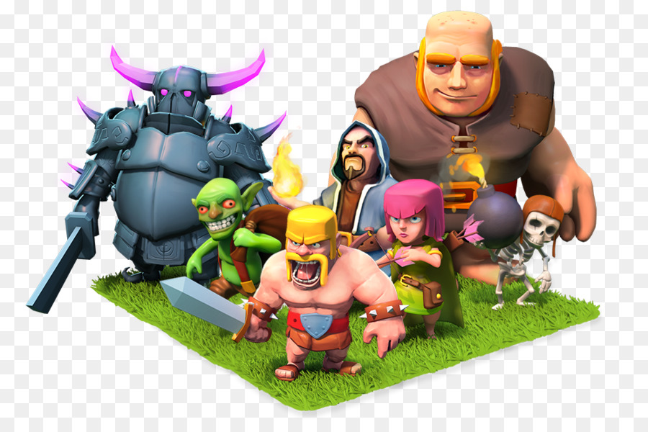
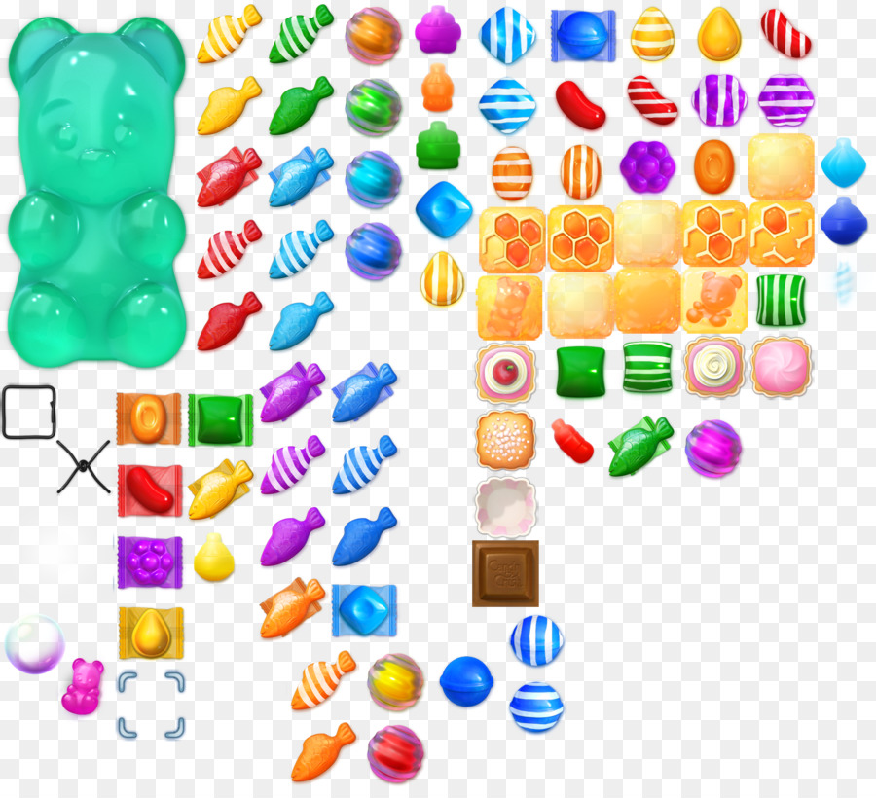
Games & Puzzle
01
To determine the movement of game character.
02
Prompting suggestions to player. Example: Candy Crash
03
Automated movement of characters. Example: Clash of Clans

Slide 15

Attack Plan in War
01
Spying the war zone
02
Determining weak points
03
Avoiding the eyes of enemy

Slide 16
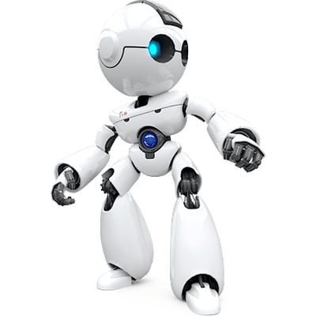
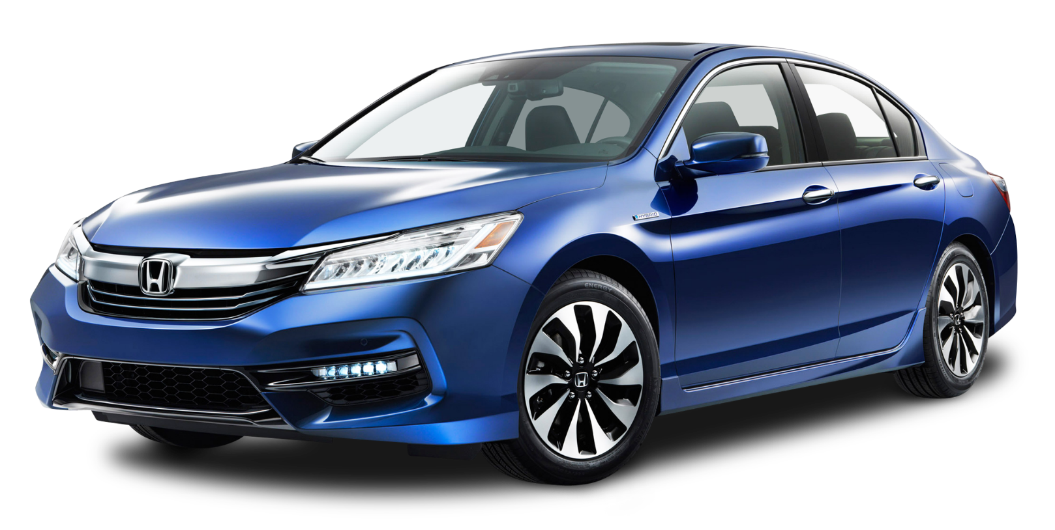
Artificial Intelligence & Navigation
01
Robots, self driving vehicles use maze path finding algorithm.
02
Using lens & sensor if robots sense blockage, they change their path.
03
In maps, to determine traffic jam on road and choose an alternate way.

Slide 17
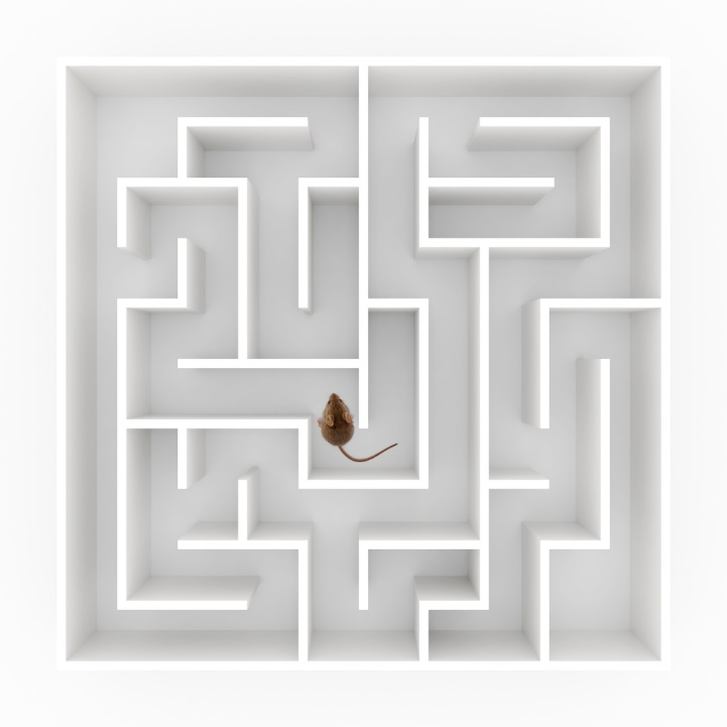
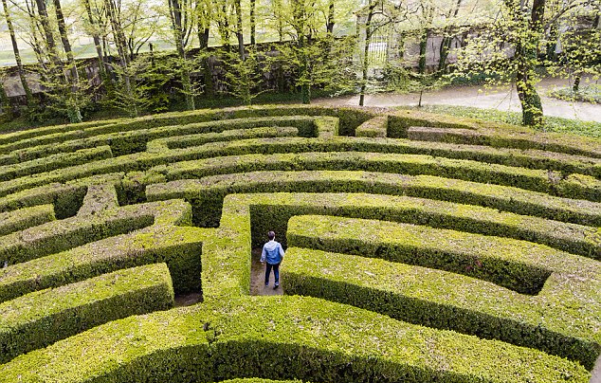
Psychological Experiment
Mazes are used in psychology experiments to study spatial navigation and learning.
01
02
Mostly used in rodents to discover their spatial conscience, memory and decision making.
03
To understand the analytical and decision making capability of a human.

Slide 18
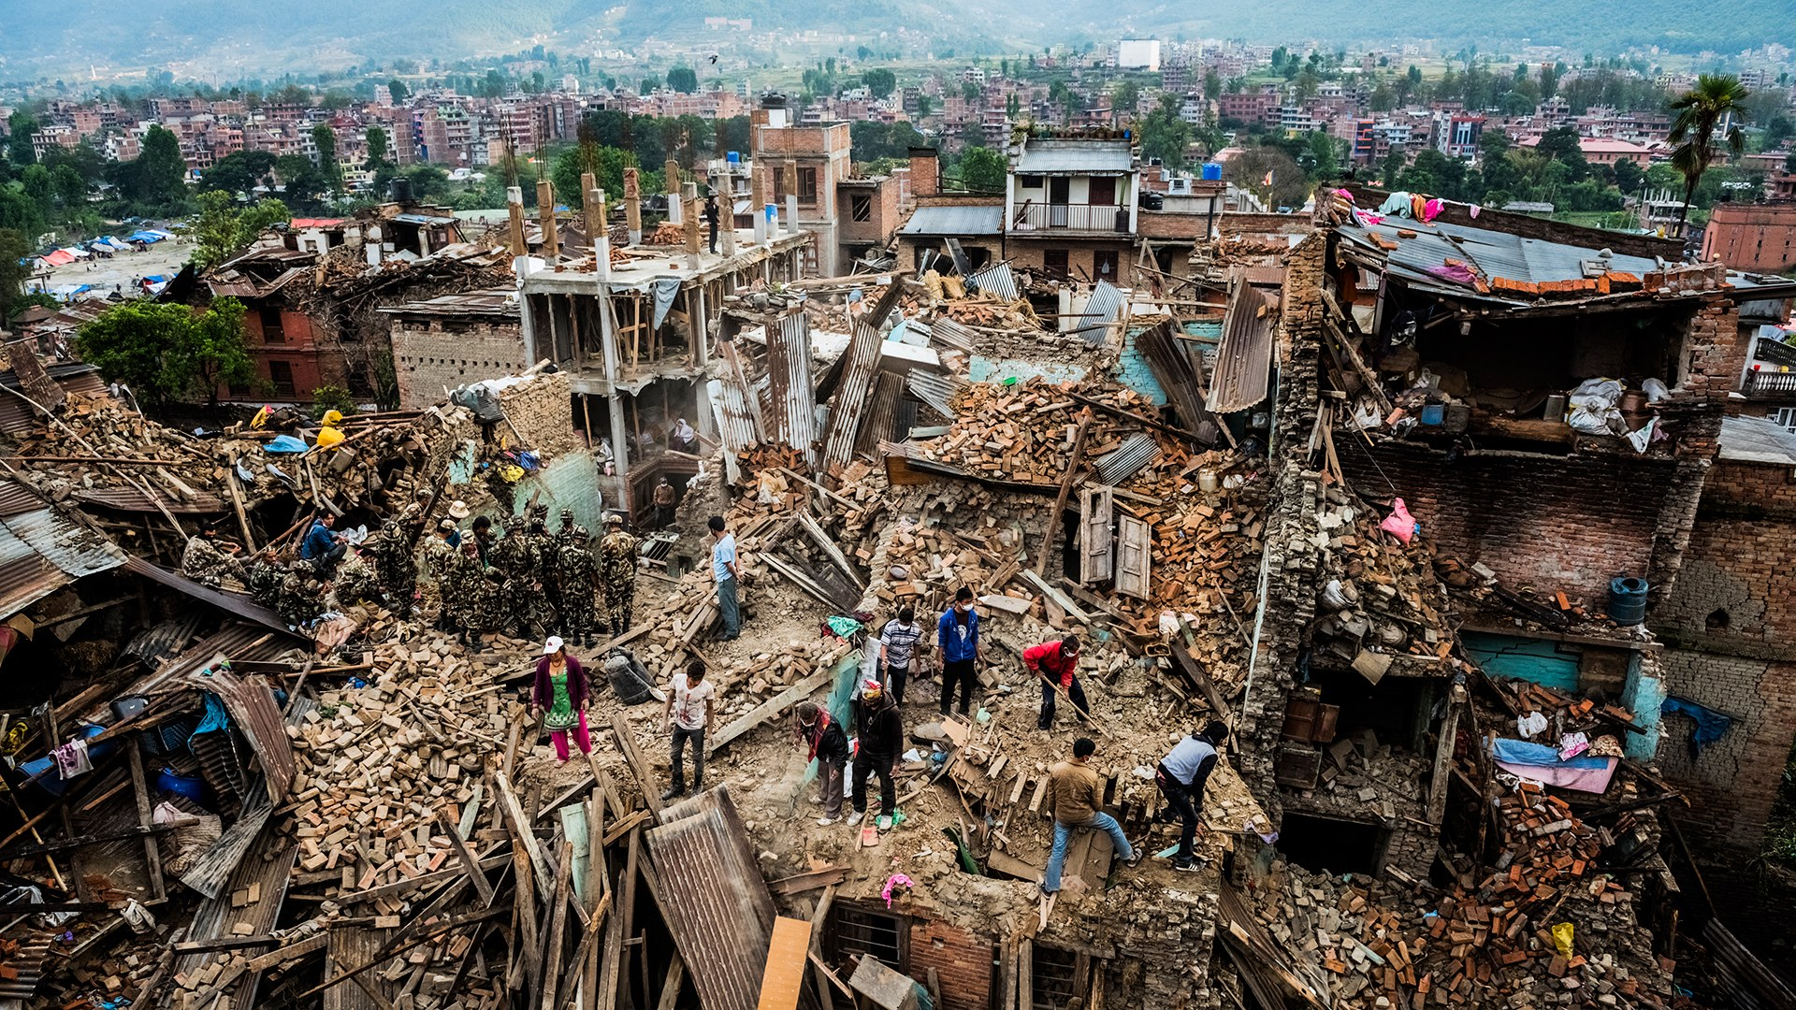

Rescue Mission
01
To create a simulation based on the disaster
02
Scanning the affected area and determining the blockage.
03
Creating safe paths for rescuing.

Slide 19
At the End
Planning on improving the program.
Planning to Implement other algorithms to find the shortest among the found paths.
Graphics work can be implemented on the program.
The program can be developed more where it will be able to generate random mazes and solve them.

Slide 20
Thank you!
Any questions?

